Slide 1
Analytics in Medicine
Cancer Radiotherapy Evaluation

Slide 2
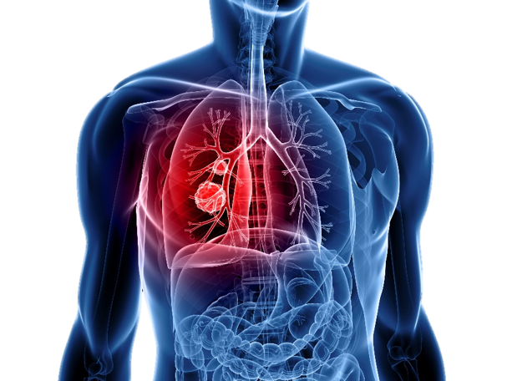
Cancer
This year:
1.7 million new cases of cancer expected
Almost 610,000 cases are expected to die
Recent trends:
Last 10 years: Survival rate up to 68%
2.3 million fewer deaths between 1991 to 2015
Treatments:
Surgery
Chemotherapy
Radiation therapy
https://vimeo.com/87395486

Slide 3
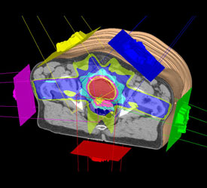
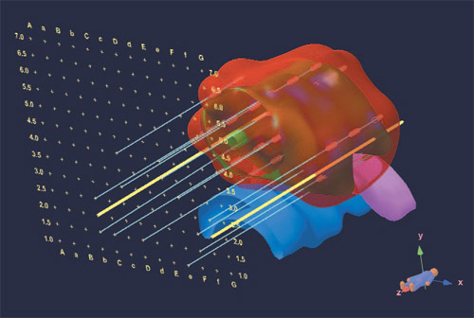
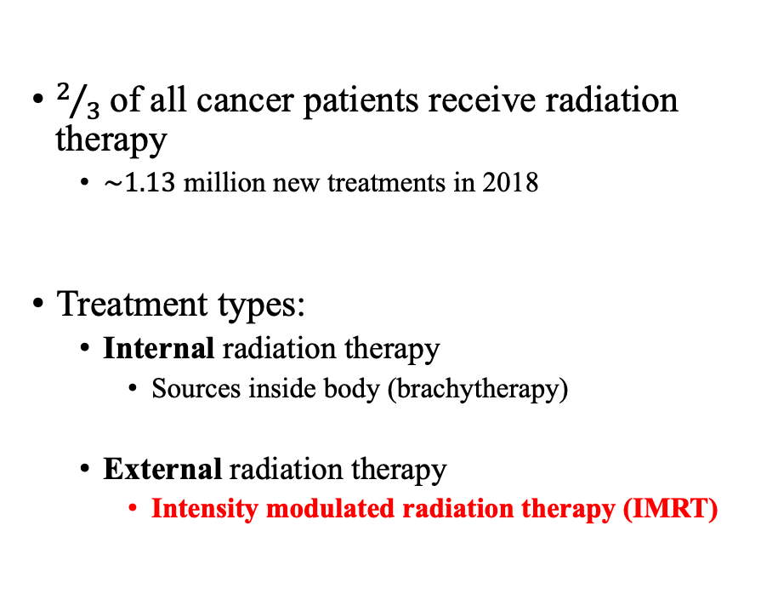
Radiotherapy
$2/3$of all cancer patients receive radiation therapy
$\sim 1.13$ million new treatments in 2018
Treatment types:
Internal radiation therapy
Sources inside body (brachytherapy)
External radiation therapy
Intensity modulated radiation therapy (IMRT)
https://visualsonline.cancer.gov/images/9413-preview.jpg
www.healthcare.philips.com/pwc_hc/main/shared/Assets/Images/Ros/Product/p3imrt/ imagegallery/ig_IMRT_Head2- 9- beam- ODM_03_main.jpg

Slide 4
Quality Control in IMRT
Typical IMRT quality control involves quality assurance (QA) of LINACs.
Dose checks on phantoms.
Alternatively, retrospective studies can measure quality through treatment outcomes.
Toxicity
Recurrence
Survival (short term/long term)
Limited in evaluating plan quality before treatment delivery.
Otherwise, a quality check can benefit new directions in automated planning, knowledge-based planning, use of machine learning, etc.
Challenges:
Limited availability of large-scale treatment planning data management tools.
Most planning systems can only evaluate, query, visualize, model single patients at an instance.
DVH Analytics (open source) https://github.com/cutright/DVH-Analytics
Radiotherapy app that can import and analyze non-image-based patient files using a SQL database, which has the capability to evaluate, compare, benchmark, and predict outcomes of multiple plans.
Many sources of variations affecting plan quality.
Variations in treatment planning systems, treatment planners, patients, physicians, institutions, etc.
An adjusted quality control tool for monitoring plan quality

Slide 5
Proxy for Quality
Dose-Volume Histogram (DVH)
100
Tumor
Volume [%]
Organs
0
100
Dose [%]
Tradeoff between objectives leads to subjective preferences.

Slide 6
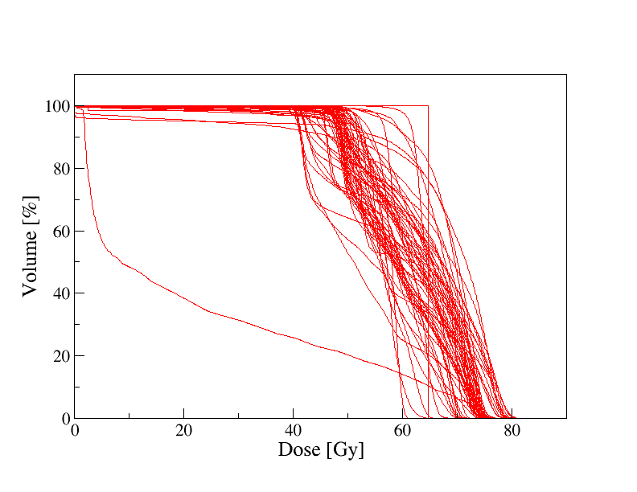
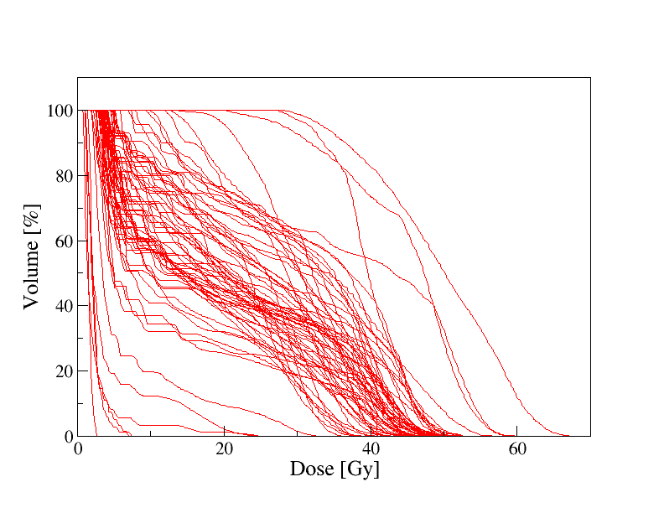
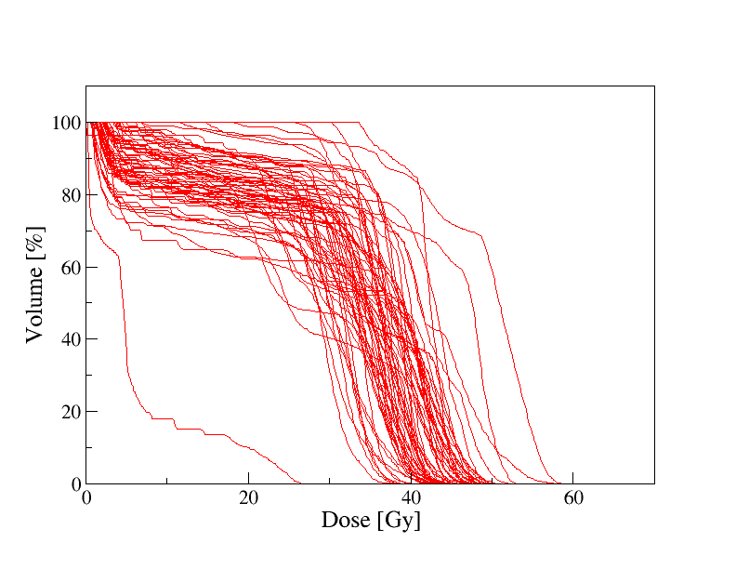
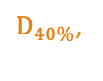
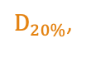
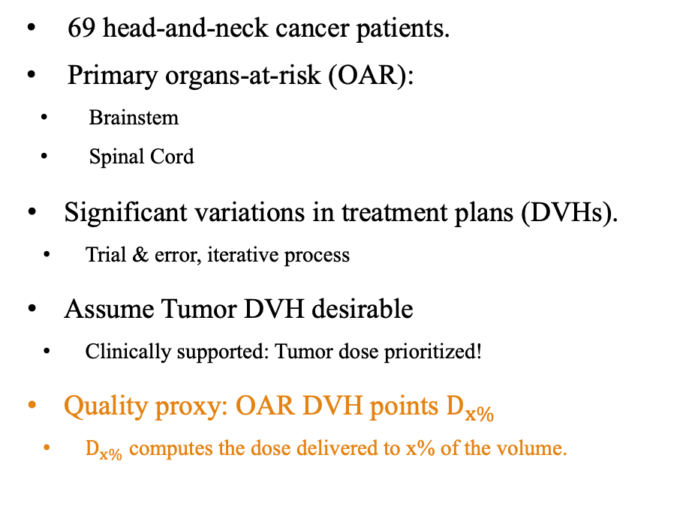
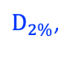
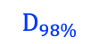
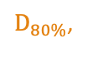
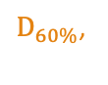
Tumor
Clinical Cases
69 head-and-neck cancer patients.
Primary organs-at-risk (OAR):
Brainstem
Spinal Cord
Significant variations in treatment plans (DVHs).
Trial & error, iterative process
Assume Tumor DVH desirable
Clinically supported: Tumor dose prioritized!
Quality proxy: OAR DVH points $D_{x\%}$
$D_{x\%}$ computes the dose delivered to x% of the volume.
Brainstem
Spinal
Cord
$D_{2\%}$,
$D_{20\%}$,
$D_{40\%}$,
$D_{60\%}$,
$D_{80\%}$,
$$D_{98\%}$$

Slide 7
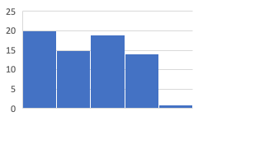
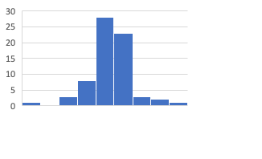
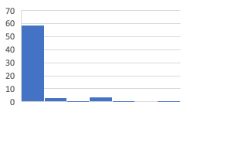
Motivation
Large variations in plans, especially for OAR sparing
DVH data is often skewed
Lack of functional form modeling relationships for D_{x}
Linear models cannot account for non-linear relationships
Need for machine learning algorithms
Non-parametric and does not rely on functional forms to model relationships
Dose [Gy]
Cord D₂
Dose [Gy]
Cord D₈₀
Dose [Gy]
Cord D₉₈

Slide 8
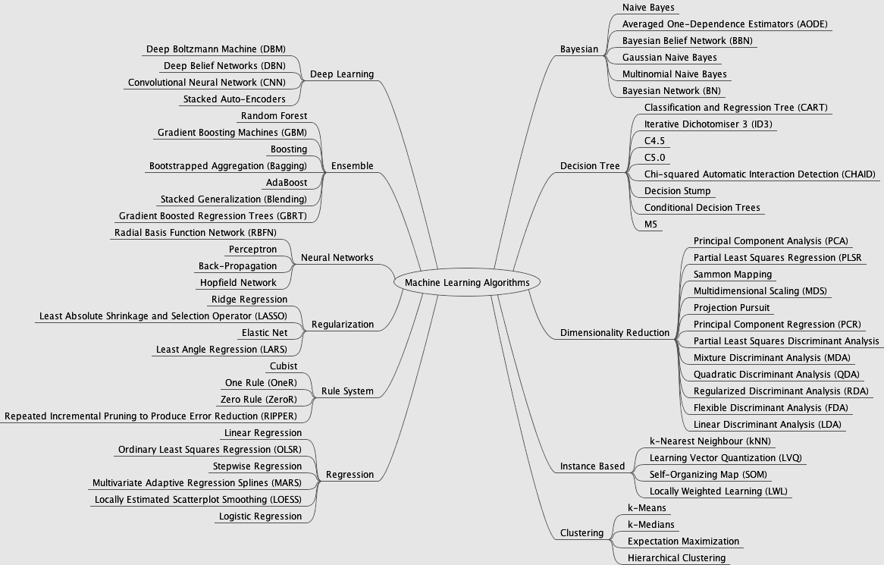
Machine Learning Algorithms
Image source: https://cdn-images-1.medium.com/max/2400/1*xMwqdbPMm3l_1cOVHAUYcQ.png
Random Forest
Decision Trees
Gradient Boosted Trees
Support Vector Machine (SVM)

Slide 9
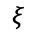
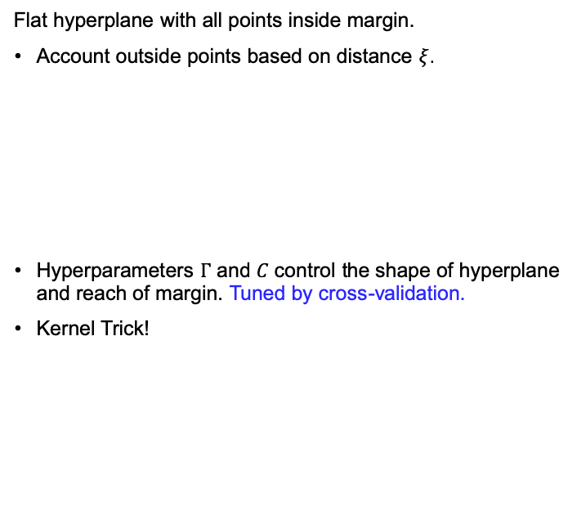
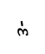
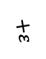
Machine Learning Algorithms
Support Vector Machines
Decision Trees
Flat hyperplane with all points inside margin.
Account outside points based on distance $ξ$.
Hyperparameters $Γ$ and $C$ control the shape of hyperplane and reach of margin. Tuned by cross-validation.
Kernel Trick!
Partition the dataset into small similar segments.
Split based on criteria
left: yes; right: no.
Keep splitting until data similar in leaf node.
Avoid by:
Pruned based on cross-validation.
Grow smaller trees!
Decision Tree
Cord
$$ξ$$
$$−ε$$
$$+ε$$
Can cause overfitting but easier to interpret.
y
z² = x² + y²
y
Pruned
Decision
Tree
Transform dimension
Equivalent
x
x
y

Slide 10
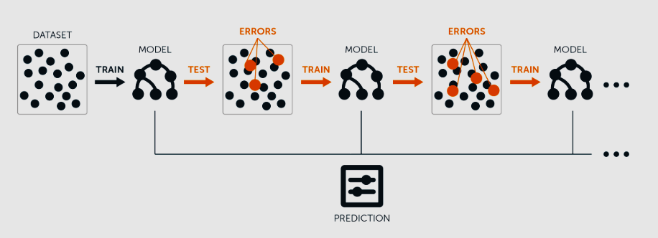
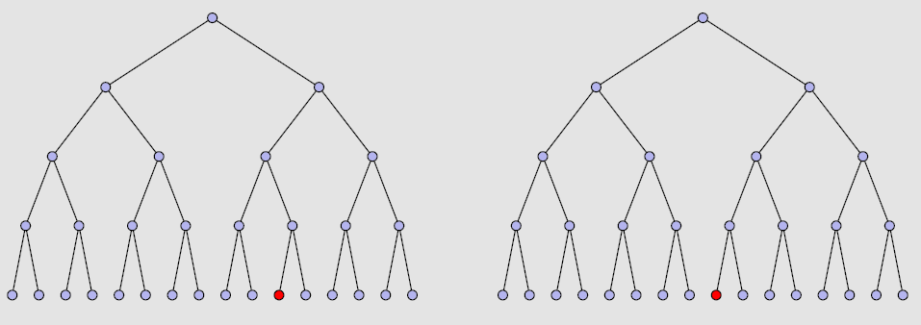
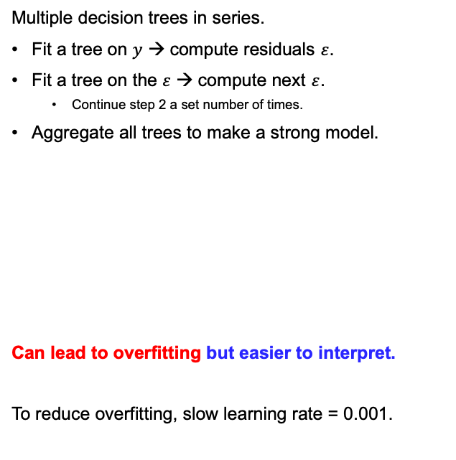
Machine Learning Algorithms
Gradient Boosted Trees
Random Forest
Multiple decision trees in series.
Fit a tree on $y$ → compute residuals $ε$.
Fit a tree on the $ε$ → compute next $ε$.
Continue step 2 a set number of times.
Aggregate all trees to make a strong model.
Can lead to overfitting but easier to interpret.
To reduce overfitting, slow learning rate = 0.001.
Many many uncorrelated decision trees.
Random sampling of training data for each tree.
Random subset of predictors when splitting.
Grow the trees as large as possible and many trees.
Take average of predictions across the trees.
Reduces overfitting and easier to interpret.

Slide 11
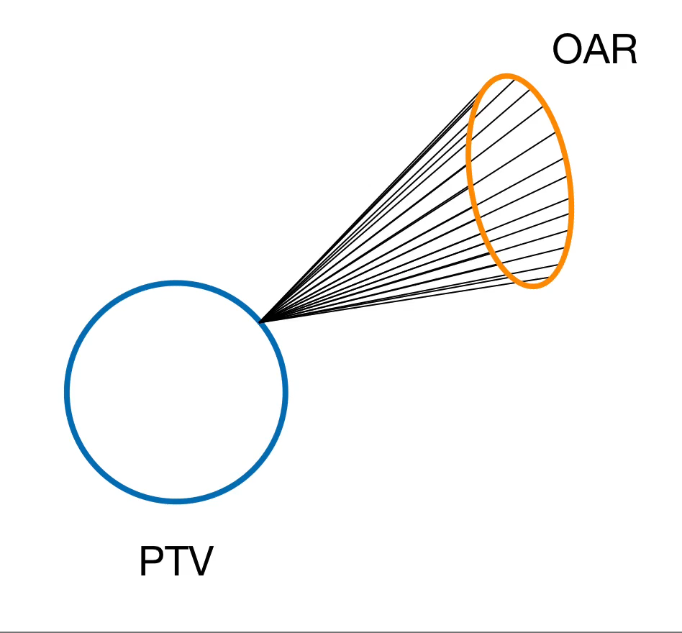
An Anatomy-adjusted Quality Control Tool for Cancer Radiotherapy Plan Evaluation
Parametrizing Anatomy
Structure Geometry
Volume
Cross-sectional Area
Area of polygon spanning structure contour on median CT slice
Spread
Maximum distance in x, y, or z-directions.
Surface Area
Area of polygons of structure contours on top and bottom slices, plus, surface area on intermediate slices.
For intermediate slices, product of contour perimeter and slice thickness.
For multiple segments on slices, area is summed.
Spatial Information
Minimum distance between tumor and OAR
Across all voxels in both structures, smallest distance between the two structures.
Distance between tumor and OAR centroids
Distance between centers of masses of both structures.

Slide 12

Spinal Cord $D_{2}$
Method | Error (MSE)
Linear Regression | 37.23
Gradient Boosted Tree | 27.87
Support Vector Regression | 27.70
Unpruned Decision Tree | 26.39
Pruned Decision Tree | 26.35
Random Forest | 7.19
All model hyperparameters were tuned using cross-validation

Slide 13

Brainstem $D_{2}$
Method | Error (MSE)
Unpruned Decision Tree | 81.69
Gradient Boosted Tree | 80.98
Pruned Decision Tree | 75.73
Support Vector Regression | 60.13
Linear Regression | 56.24
Random Forest | 17.76
All model hyperparameters were tuned using cross-validation

Slide 14
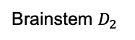
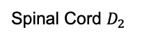
Random Forest: Variable Importance
Relative importance of variables in models.
Spinal Cord $D_{2}$
Brainstem $D_{2}$

Slide 15

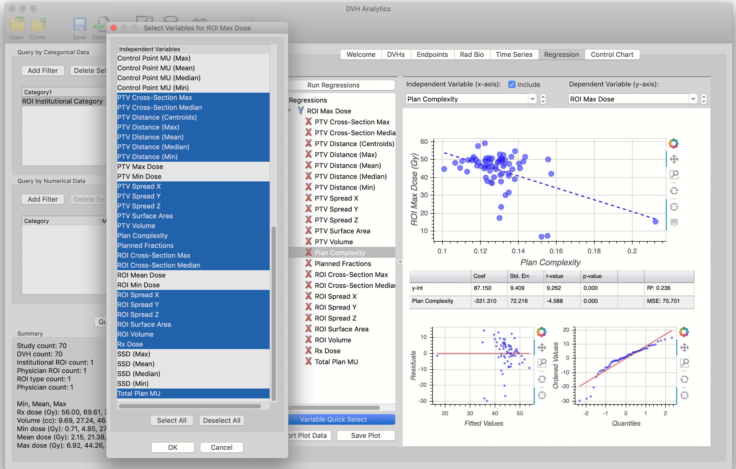
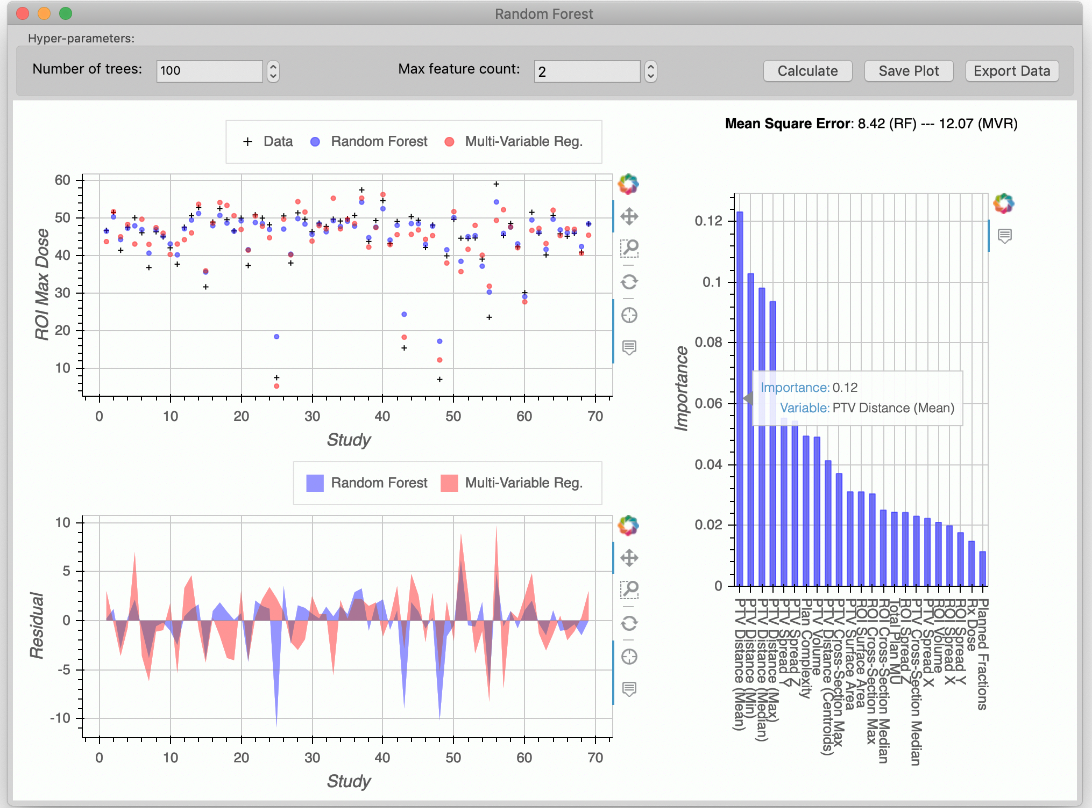
Software: DVH Analytics
An open-source database application for machine learning and statistical modeling of DICOM-RT data.
Available on GitHub at www.dvhanalytics.com
Cutright, et. al (2018). DVH Analytics: A DVH database for clinicians and researchers. Journal of Applied Clinical Medical Physics, 19(5), 413-427.

Slide 16
Cancer Prediction Case-Study
Background: Accurate Diagnosis of Breast Cancer is of prime importance. Fine Needle Aspiration test or "FNA”, which has been used for several years in Europe, is a simple, inexpensive, noninvasive and accurate technique for detecting breast cancer. Expending the suitable features of the Fine Needle Aspiration results is the most important diagnostic problem in early stages of breast cancer¹.
Data Set Information: Features are computed from a digitized image of a fine needle aspirate (FNA) of a breast mass for breast cancer patients. They describe characteristics of the cell nuclei present in the image.
Attribute Information: 1) Patient ID number; 2) Diagnosis (M = malignant, B = benign); 3-32) Ten real-valued features are computed for each cell nucleus:
a) radius (mean of distances from center to points on the perimeter); b) texture (standard deviation of gray-scale values); c) perimeter; d) area; e) smoothness (local variation in radius lengths)
f) compactness (perimeter^2 / area - 1.0); g) concavity (severity of concave portions of the contour); h) concave points (number of concave portions of the contour); i) symmetry;
j) fractal dimension ("coastline approximation" - 1). All feature values are recoded with four significant digits.
The mean, standard error and "worst" or largest (mean of the three largest values) of these features were computed for each image, resulting in 30 features. For instance, column 3 is Mean Radius, column 13 is Radius SE, column 23 is Worst Radius.
Class distribution: 357 benign, 212 malignant.
Task: free to use any predictive modeling algorithm. Separate the data into training set and testing set and try to identify the best suited model for predicting the class (B or M) of the patient. Additionally, find important features from the data with respect to explainability and predictive power. Discuss the tradeoffs of different methods you tried.
1. Introduction of a New Diagnostic Method for Breast Cancer Based on Fine Needle Aspiration (FNA) Test Data and Combining Intelligent Systems

